Slide 1



PESCAO
EU-ECOWAS Regional Programme for Improved Regional Fisheries Governance in Western Africa
ECOWAP
Ms. Isabelle Viallon & Dr. Aboubacar Sidibé
Kick-off meeting of Component 3 of PESCAO and of DEMERSTEM project,
From 5 to 8 March 2019 in Saly, Senegal.
« …ECOWAS OF PEOPLE…»

Slide 2
ECOWAP
The outcome of a long story…called PESCAO
2014-2015 Discussion and adoption of the Regional Indicative Program (RIP)
2016 Identification and formulation of the PESCAO AD; FIRST expert is recruited
1st semester 2017 Adoption of the EU decision and signature of the convention with ECOWAS; 2nd semester 2017 Preparation of the implementing contracts and launch of the call for proposal
2018 Launch of the activities and 1st Steering committee
2014 Adoption of the AU PFRS
« …ECOWAS OF PEOPLE…»

Slide 3
ECOWAP
General Information on PESCAO
Financing Agreement (No. ROC/FED/038-922): Signed on 15 June 2017.
Duration of the Program: 60 Months.
Total estimated cost of the Program: 15,500,000 Euros.
Main Source of Funding: The European Union (11th EDF) and the ECOWAS Commission.
Regional coverage: West Africa (15 ECOWAS Member States and Mauritania).
Execution Arrangement: ECOWAS Commission (D/A&RA) as Program Manager ensures overall coordination of the implementation of the PESCAO in collaboration with the EUD of Abuja (Nigeria) and UEMOA.
« …ECOWAS OF PEOPLE…»

Slide 4
ECOWAP
Recall of PESCAO’s Objectives:
The overall objective is to enhance the contribution of fisheries resources to sustainable development, food security and poverty alleviation in West Africa.
The specific objective is to improve regional fisheries governance in Western Africa through better coordination of national fisheries and aquaculture policies.
« …ECOWAS OF PEOPLE…»

Slide 5
ECOWAP
The main expected results by Component (C) are:
C1-Result area 1: A Western African fisheries and aquaculture policy is developed and coordination of regional stakeholders is improved.
C2-Result area 2: Prevention of and responses to IUU fishing are strengthened through improved Monitoring, Control and Surveillance (MCS) at national and regional levels.
C3-Result area 3: Marine resources management at the regional level is improved, building resilience of marine and coastal ecosystems to perturbations.
« …ECOWAS OF PEOPLE…»

Slide 6




ECOWAP
Structure of the PESCAO Programme
Regional Steering Committee
Of PESCAO
Component 1
Regional governance
ECOWAS/UEMOA
(Technical Assistance)
Component 2
MCS and fighter against IUU fishing
EFCA
SRFC
FCWC
Coastal states
Coastal states
Component 3
Management of shared resources
Project 1
Project 2
Project 3
« …ECOWAS OF PEOPLE…»

Slide 7
ECOWAP
Key Principles
PESCAO programme is a regional program
1st attempt in working with competent regional organisations in coordination with other donors
Partnership and complementarity approche
Autonomy doesn’t mean isolation!
Fisheries are now part of EU-ECOWAS cooperation = opportunity for a more structured dialogue
« …ECOWAS OF PEOPLE…»

Slide 8
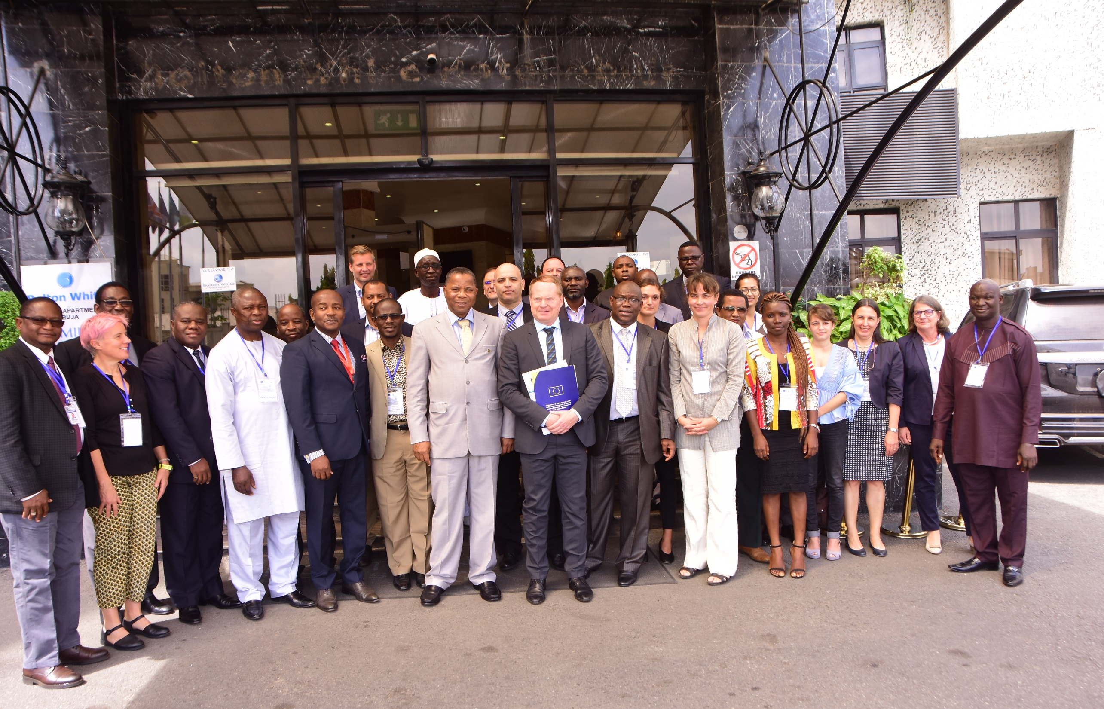
THANK YOU
MERCI
OBRIGADO
1st PESCAO Programme Steering Committee Meeting held from 7th to 8th, November 2018 in Abuja, Nigeria

Slide 9

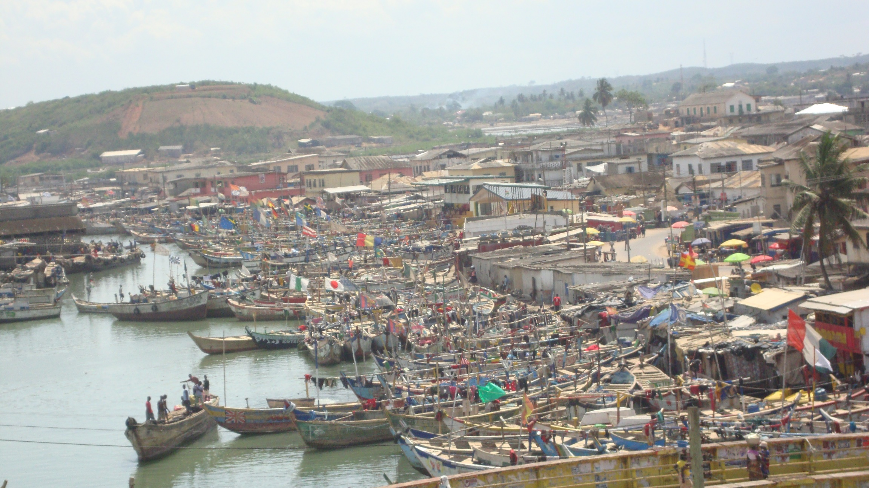

THANK YOU
MERCI
OBRIGADO
ECOWAP
« …ECOWAS OF PEOPLE …»

